Slide 1



Tablero Prototipo - PIA
View in Power BI
Last data refresh:
21/03/2024 20:55:51 UTC
Downloaded at:
21/03/2024 20:57:57 UTC

Slide 2
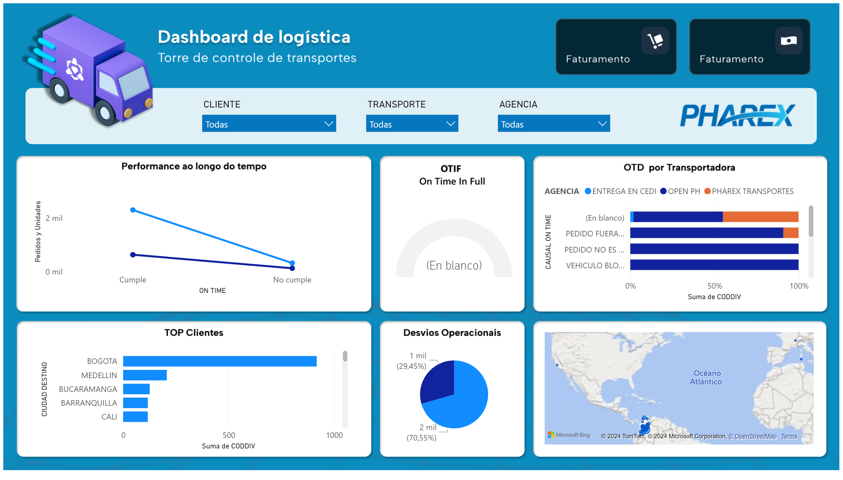
Notes:
image
No alt text provided
barChart
No alt text provided
pieChart
No alt text provided
map
No alt text provided
hundredPercentStackedBarChart
No alt text provided
gauge
No alt text provided
lineChart
No alt text provided
slicer
No alt text provided
slicer
No alt text provided
slicer
No alt text provided

